Slide 1


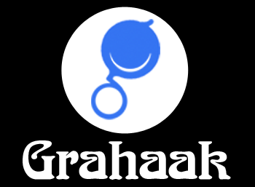
Comprehensive Solution to increase productivity of your Sales Force.
www.grahaak.com

Slide 2



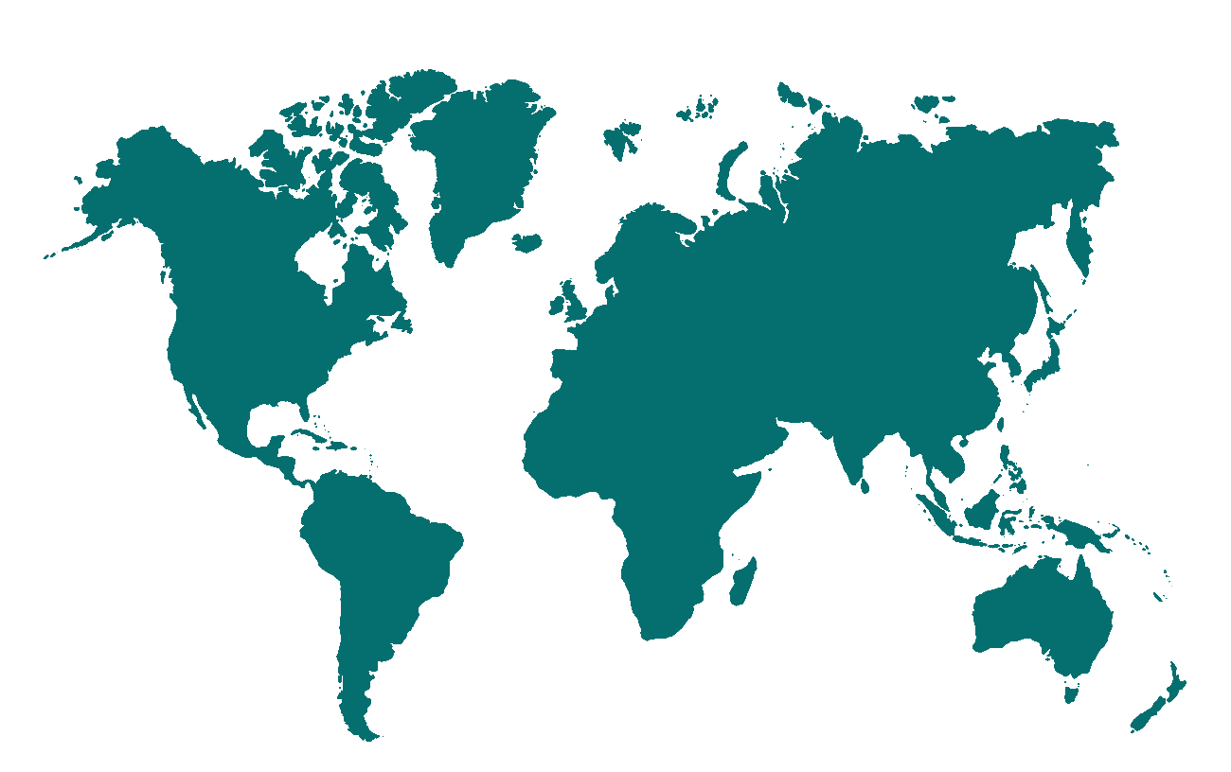
Dataman Introduction
Sales & Distribution Focus
Dataman Intro
Single Platform For Secondary Sales & Distribution
More than Decade of operations
Focused on FMCG and Food/Beverages sales and Distribution solutions.
Covers all Areas of Secondary Distribution:
Currently 100000+ users on Platform
Team size of 410+ Team
ISO 27001 Certified
Blue Chip Customer Base
Global Presence
More than 40 FMCG Customers in 35+ Countries across India subcontinent, SEA, Middle East & Africa
Dataman offices:
- India
- Dubai
- USA
Covers FMCG, Food, Beverages, Dairy, Ice-cream, Auto Spares etc..
Partners:
Multiple countries

Slide 3



Grahaak - Our Products
Grahaak Field
2
3
Grahaak Distributor
Grahaak Manager
1
4
Grahaak CRM

Slide 4


Grahaak Field App - Features
Secondary Sale
Primary Sale
Beat Plan
On Spot New Outlet Creation
See Route for Outlet on Google Map
Retailer Order
Payment Collection from Outlet
Demo Details
Failed Visit Details
Competitor Goods at Outlet
Live Notifications
Reports
Geo Location
Distributor Order
Stock of Distributor
Distributor Payment Collection
Discussion for Distributor
Failed Visit Entry
Reminders for next Regular Visit/Failed Visit
Notifications
Reports
Geo Location
Other Activities
Leave Details
Tour Details
Expense Request
Purchase Order
Complain/Suggestion
Collateral
Invoice Pdf Generation
Head Office
Depo
Meet

Slide 5

Grahaak Manager App - Features
Dashboard
Sales Rep Sales Analysis
Distributor Sales Analysis
Ledger
Pending Order
Latest Sale Invoices
Daily Sales Report Approval/Rejection
Leave Approval/Rejection
Beat Plan Approval/Rejection
Tour Approval/Rejection
Expenses Approval/Rejection
Attendance. Retailer Summary, Primary, Secondary sales Report
Sales Rep Live Position
Complain/Suggestion
Collateral

Slide 6




Grahaak App - Features
Primary Sales Report
Person Target
Pending Orders
Latest 5 sale Invoice
Purchase Order, Reporting
Distributor dashboard with Invoices, Purchase Order with Status, Ledger
Complain/Suggestion
Collateral
Contact Creation
Task Dashboard
Follow-Up
Call/Email
Notes
Deals
Action History
Payment
Payment Ledger
Leave Request
Tour Plan
Expense Management
Advance Expence Request
Collateral

Slide 7
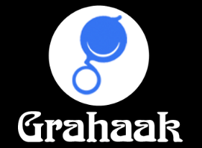

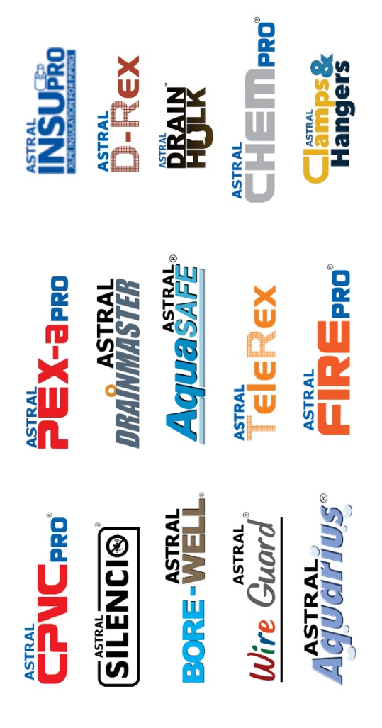
Successful Implementation
ASTRAL PIPES
Product Used And Advantages
DM Tracker – To track user’s live location and there working.
Grahaak - Grahaak is a single platform with multiple products offered. Country wise products can be selected and deployed. Used to track sales and working.
The configurable capabilities helped each country to design its own tailor made process for each customer segment they servicing.
1000+ active users across the country.
Client Feedback
The major part of every product is its support services and solutions in which Grahaak provides 100% results.
The configurable capabilities helped each country to design its own tailor made process for each customer segment they servicing

Slide 8
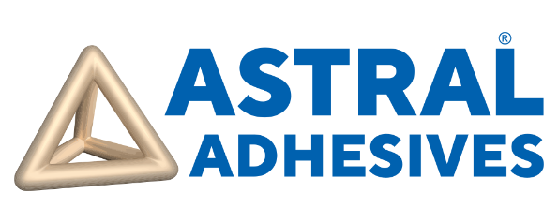
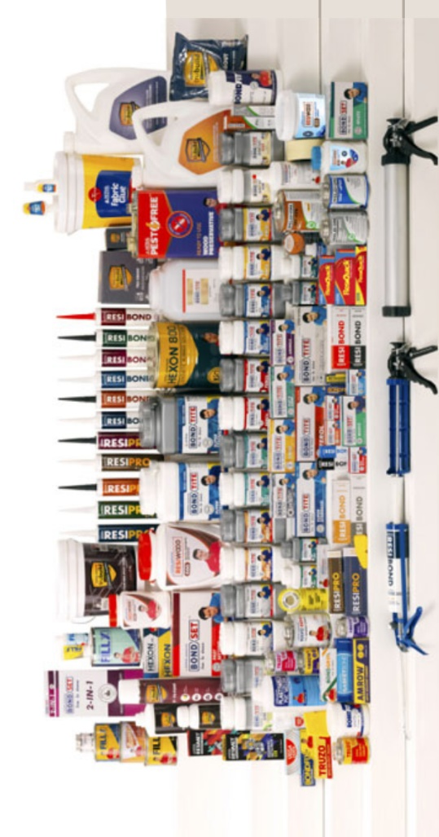
Successful Implementation
ASTRAL ADHESIVES
Product Used And Advantages
DM Tracker – To track user’s live location and there working.
Grahaak - Grahaak is a single platform with multiple products offered. Country wise products can be selected and deployed. Used to track sales and working.
The configurable capabilities helped each country to design its own tailor made process for each customer segment they servicing.
1000+ active users across the country.
Client Feedback
The major part of every product is its support services and solutions in which Grahaak provides 100% results.
The configurable capabilities helped each country to design its own tailor made process for each customer segment they servicing

Slide 9

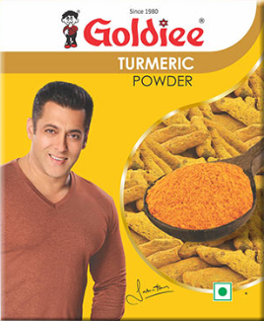

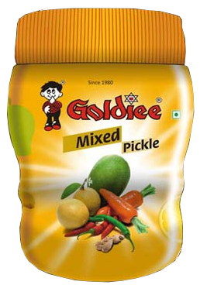
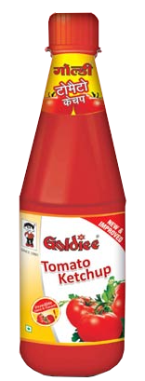
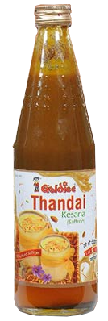
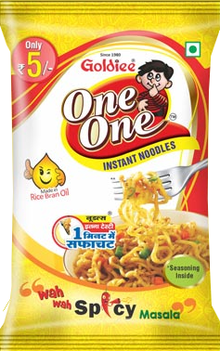
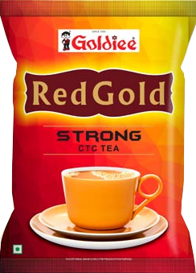
Successful Implementation
GOLDIEE
Product Used And Advantages
Lakshya Marketing – With 150+ users for marketing persons.
Lakshya Distributor – Distributor app with 1100+ users for the dealers and distributor with all the features used to interact with the company directly.
Client Feedback
User friendly environment with excellent support system.
Complex integrated eco-system of diverse systems.
Management of complete Distributor network at the times of COVID situations.

Slide 10

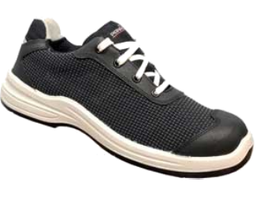
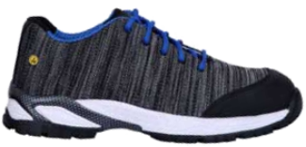
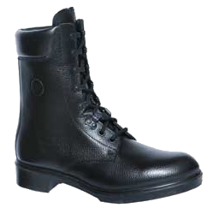
Successful Implementation
SUPER HOUSE
Product Used And Advantages
Grahaak CRM – Complete management of the employee chain with all the facilities for Lead management, Task Management, Contact management and many more features.
A complete solution to connect the front office works to the back office works with work smoothness.
Client Feedback
Easy to use both for employees and for the Admin.
Well maintained reporting system for all levels in an Organization.
User friendly environment with excellent support system.

Slide 11

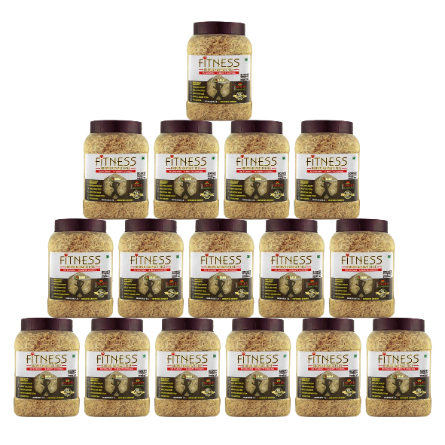
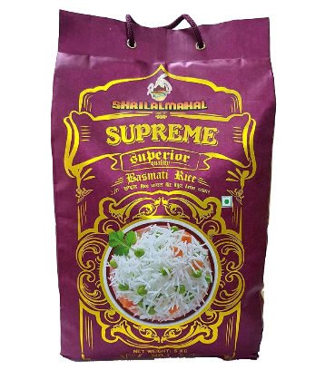
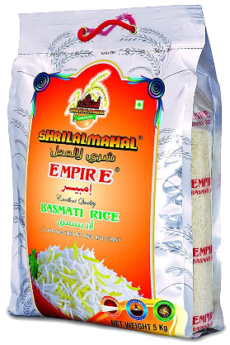
Successful Implementation
SHRI LAL MAHAL
Key Highlights
Countries of Implementation : 33 Countries (SEA, SA, GCC, ME & Africa)
Number of Users: Around 22000+,
Number of visit by salesman – 1.3+ Million Visits daily
Products : XnappSales PreSales, VanSales, Route Tracking, Reports &Analytics,
SubDB Platform, GoOrdR B2B App (Country wise Products implementation)
Major Pain Points
Grahaak Advantage
Disparate systems across geography
Diverse requirements of each countries
Business dependent complexities e.g. Icecream, FMCG, Food etc..
Complex integrated eco-system of diverse systems
Grahaak is a single platform with multiple products offered. Country wise products can be selected and deployed.
The configurable capabilities helped each country to design its own tailor made process for each customer segment they servicing

Slide 12

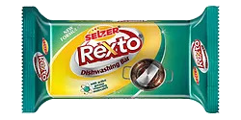
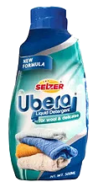
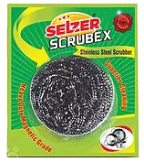

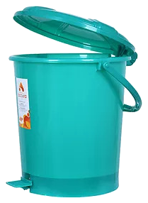
Successful Implementation
SELZER
Product Used And Advantages
Grahaak Field – A complete solution to manage all the activities done by the field force in his day to day working with all types of reporting's for all levels.
Grahaak Manager – A solution provided to the manager level and to the admin to check the reporting of the sales force on there handhelds.
Client Feedback
User friendly environment with excellent support system.
Smooth working integration with the ERP System making data much accurate and compact.

Slide 13





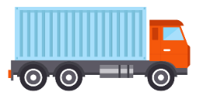




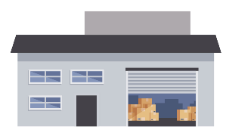

Serving Multiple Distribution Models
Direct Distribution
In-Direct Distribution ( 1-tier )
In-Direct Distribution ( n-tier )
1
Manufacturing Unit
Tertiary Outlets
2
Manufacturing Unit
Distributor / Wholesaler
Tertiary Outlets
3
Manufacturing Unit
Distributor / Wholesaler
Sub Distributor
Tertiary Outlets

Slide 14






N-tier Distribution Channel Support
Tertiary Outlets
Primary Distributor Services Secondary Outlets And SubDTs
Outlets
Tertiary Outlets
SubDT
Distributor
Tertiary Outlets
PRINCIPAL
Outlets
Tertiary Outlets
Outlets

Slide 15




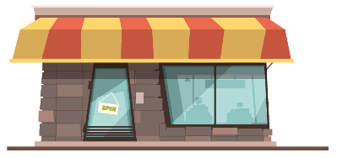
N-tier Distribution Channel Support
Secondary sales invoice with price and secondary discount (for an outlet of type Sub-DT)
Purchase Invoice with qty, tertiary sales price (considering SubDB margin) and primary discount to STS ledger
Sub Distributor
Tertiary Outlet Sales
Distributor
Sales Return
Purchase Return
Tertiary Outlets

Slide 16
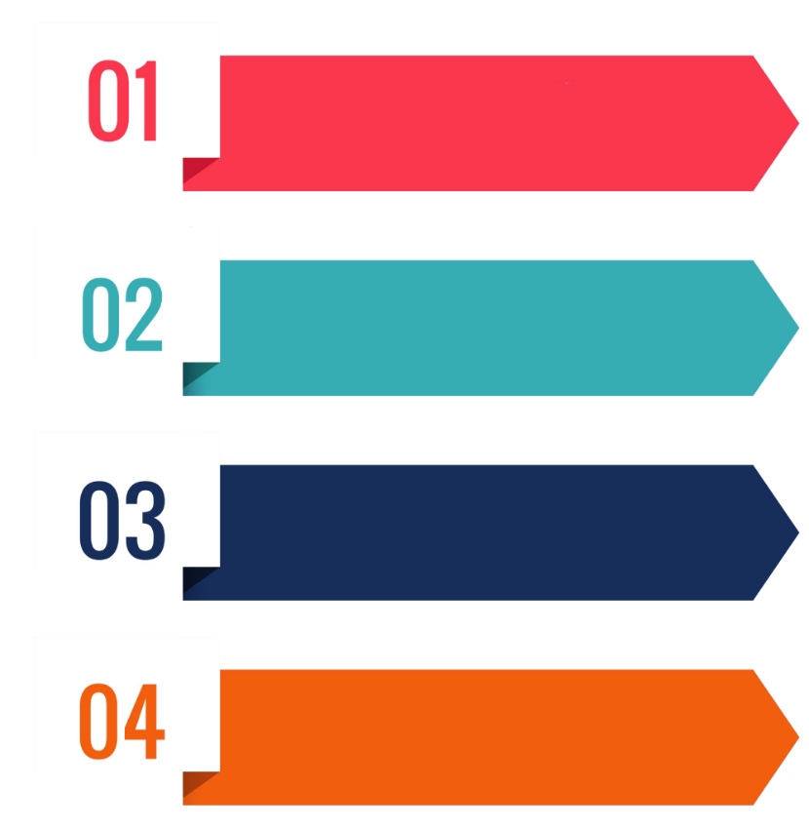















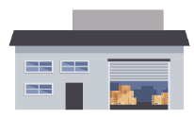



Grahaak - Products & Solutions
Solution
ERP Integration App
How To Manage ?
Solution
Dealer / Distributor App
Solution
Field / Employer App
Document Management System
Solution
Reporting Web / App
Manage DMS
Perfect Solution !
Manufacturing Unit
(Manage All Data)
Distributor
Sub Distributor
Tertiary Outlets

Slide 17






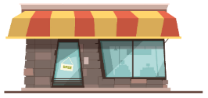






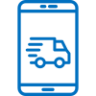
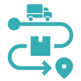



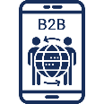








Grahaak - Products & Solutions
Distributor & Stakeholder Collaboration And Operations Management
Central
Central Reporting
Grahaak BI
Grahaak ML & Forecasting
Grahaak Enterprise Connectors
Grahaak – Distributor Management
Grahaak – Supply Chain
DMS
DMS Reporting & Dashboards
DMS Lite
DT Mobile App (Beta)
Delivery Route Optimization
Asset Tracking & PoD
Cold Chain Visibility
GoOrdr - Digital RTM
Inside Sales
Grahaak - FoS RTM
In Store Execution
Market Development
B2B & B2C Web Store
B2B Mobile App
Inside Sales
Grahaak PreSales
Grahaak Van Sales
Grahaak Sight For Team Leads
Grahaak Merchandising
Grahaak Survey
Geo Coder & Survey
Route Planning

Slide 18


